Slide 1
Lecture 10 Undecidability
Undecidable problems,
reduction via accepting computation history and
Post correspondence problem (PCP)

Slide 2
Acceptance testing problem for TM
Let ATM={<M,w>: M is a TM that accepts w}. This language is Turing recognizable.
Proof idea: Construct a TM
U=“on input <M,w>, where M is a TM and w is a string:
1.Simulate M on w.
2. If M even enters its acceptance state, accept; if M ever enter its reject state, reject” (if M ever loops?)
Note that U is not necessarily a decider.

Slide 3
Universal Turing machine and Halting Problem
program
<M>
string w
w
input
A particular
purpose TM
Universal TM
output
output
U can simulate any TM.
(Halting Problem) Decide, given a program and an input, whether the
program will eventually halt when run with that input, or will run forever

Slide 4
Decidability and Turing-recognizable
A language is co-Turing recognizable if its complement is Turing recognizable.
A language is decidable iff it is both Turing recognizable and co-Turing-recognizable.
The complement of ATM is not Turing –recognizable.

Slide 5
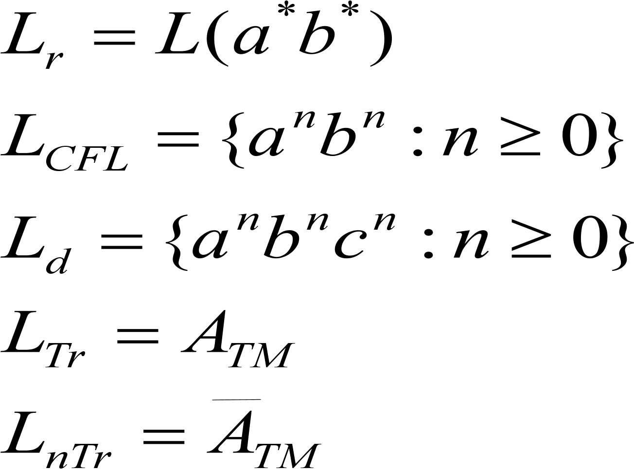
Where are we now?
Regular CFL
Regular CFL decidable Turing-recognizable
Why is the decider not regarded as a model of a general purpose computer?

Slide 6
Undecidability is the norm
There are some languages that are not Turing recognizable.
Proof idea:
the set of languages is uncountable
The set of Turing machines is countable.
An analogy in mathematics, within [0,1]
The set of rationals is countable and has a measure 0 (“negligible”);
The set of irrationals is uncountable and has a measure 1.
Note that ATM is Turing recognizable but not co-Turing recognizable.

Slide 7
Halting problem
HALTTM={<M,w>:M is a TM and M halts on w}
Proof idea: Suppose that a TM R decides HALTTM. Construct a TM
S=“On input <M,w>, where M is a TM and w an input
1.Run R on <M,w>;
2.If R rejects, reject (what does this mean?)
3. If R accepts, simulate M on w until it halts.
4. If M has accepted, accept; if M has rejected, reject.”
So TM S decides ATM, a contradiction. The famous halting problem is not decidable.
Is it Turing recognizable?

Slide 8
The emptiness testing problem for TMs
ETM={<M>: M is a TM and L(M)=0}
Proof Idea: Suppose that a TM R decides this language. Given <M,w>,construct a TM
M<M,w>=: “on input x,
1. if x is not w, reject.
2. if x =w, run M on w and accept if M accepts w.”
(*) L(M<M,w>)=0 iff M does not accept w.
Now we construct a TM S for ATM:
S=“on input <M,w>,where M is a TM and w an input
1. Construct a TM M<M,w> according to <M,w>.
2. Run R on <M<M,w>>.
3. If R accepts, reject; if R rejects, accept.”
So S decides ATM, a contradiction. The problem is not decidable.

Slide 9
The equivalence problem for TM
EQTM={<M,M’>: L(M)=L(M’)}
Proof idea: Suppose that this language is decided by a TM R. Construct a TM
S=“on input <M>, where M is a TM,
1. Run R on <M, M’>, where M’ is a TM that rejects all inputs, i.e. L(M’)=0.
2.If R accepts, accept; if R rejects, reject.”
Indeed S decides ETM, a contradiction.

Slide 10
REGULARTM is undecidable.
REGULARTM={<M>: M is a TM and L(M) is a regular language}
Proof idea: Suppose that this language is decided by a TM R. Construct a TM
S=“On input <M,w>, where M is a TM and w an input
1. Construct a TM M<M,w>
M<M,w>=“on input x:
1. If x has the form 0^n1^n, accept.
2.If x does not have this form, run M on w and accept if M accepts w.”
(L(M<M,w>) is regular iff M accepts w)
2.Run R on <M<M,w>>
3.If R accepts, accept; if R rejects, reject.”
So S decides ATM, a contradiction.

Slide 11


Rice’s Theorem
Let P be any problem about TM that satisfies the following two properties. As usual, P is expressed as a language.
For any TMs M1 and M2, where L(M1)=L(M2), we have
There exist TMs M1 and M2, where
Then P is undecidable. From Rice’s Theorem, we know the following problems are also undecidable: FINITETM,CFLTM,DECIDABLETM.

Slide 12
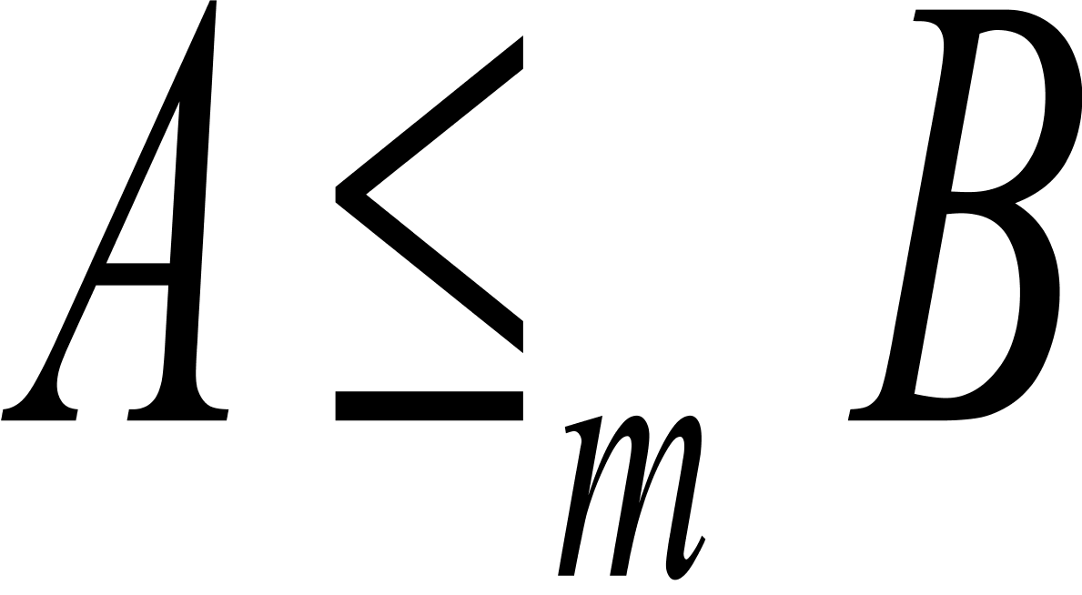
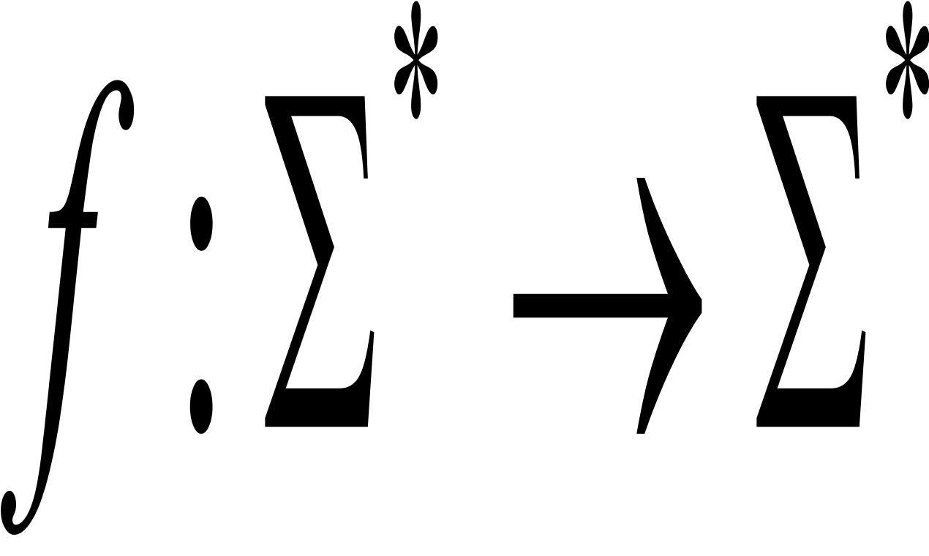

mapping reduction
A language A is mapping reducible to language B, written , if a computable function exists, where for every w,
A
B
f

Slide 13
Linear bounded automaton (LBA)
LBA: a deterministic TM with a limited memory
control
a b a a b # a b
Tape with a Limited memory:
with a larger tape alphabet
Head is not allowed to move off the tape portion containing the input.

Slide 14
Accepting Computation History
An accepting computation history for a TM M on w is a sequence of configurations C1, C2, …..,Ck exist such that
C1 is the start configuration of M on w;
Each Ci yields Ci+1 and
Ck is the accepting configuration
A rejecting computation history can be defined similarly.

Slide 15
The acceptance problem for LBA
ALBA={<M, w>: M is an LBA that accepts w}.
Proof idea: We need the following observation: Let M be an LBA with q states and g symbols in the tape alphabet. There are exactly qng^n distinct configurations of M for a tape of length of n.
Construct a TM L that decides ALBA.
L=“On input <M,w>, where M is LBA and w a string,
1. Simulate M on w for qng^n steps until it halts.
2.If M has halted, accept if it has accepted and reject if it has rejected. If it has not halted, reject.”
Consider the acceptance problem for PDA again. Can we reason as above?

Slide 16
The emptiness problem for LBA
Proof idea: Suppose that ELBA is decided by R. For <M, w>, construct a LBA B<M,w> such that B<M,w> accepts x iff x is an accepting computation history of M on w. Construct a TM
S=“On input <M,w>, where M is a TM and w string,
1.Construct LBA B<M,w>.
2.Run R on <B<M,w>>.
3.If R rejects, accept; if R accepts, reject.”
Indeed S decides ATM, a contradiction.

Slide 17
Construct B<M,w>
B<M,w> checks whether the following input
#C1#C2#C3#.....#Cl#
satisfies the three conditions
C1 is the start configuration of M on w;
Each Ci yields Ci+1 and
Cl is the accepting configuration
Can we replace B<M,w> here with a PDA doing the same checking
even if the even configurations in the input are reversed? Why?

Slide 18
ALLCFG is undecidable
ALLCFG={<G>: G is a CFG and G generates all strings}
(1?) why not use Rice’s Theorem
(2?) ECFG is decidable though!! What makes this difference?
Proof idea: Suppose that this languages is decided by a TM R. Given <M,w>, construct a PDA D such that D accepts x iff x fails to be an accepting computation history for M on w. Construct a TM
S=“On input <M,w>, where M is a TM and w string,
1.Construct PDA D;
2.Run R on D.
3.If R rejects, accept; if R accepts, reject.”
Indeed S decides ATM, a contradiction.

Slide 19
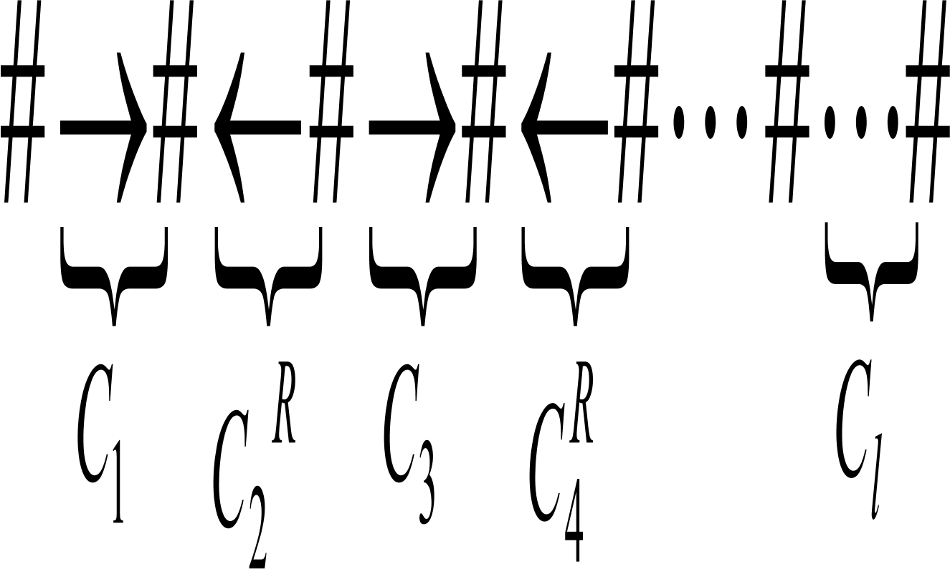
Construct the PDA D
D
Comparing adjacent configurations
according to transition function
stack
What is the difference of D from the previous LBA B<M,w>

Slide 20
The equivalence problem for CFGs is undecidable.
Let G1 be a CFG that generates all strings.
Suppose that EQCFG is decided by R. Construct a TM
S=“On input <G, G1>, where G is a CFG,
1. Run R on <G, G1>.
2. If R accepts, accept; if R rejects, reject.”
Indeed S decides ALLCFG, a contradiction.
Recall that the equivalence problem for DFAs is decidable.

Slide 21
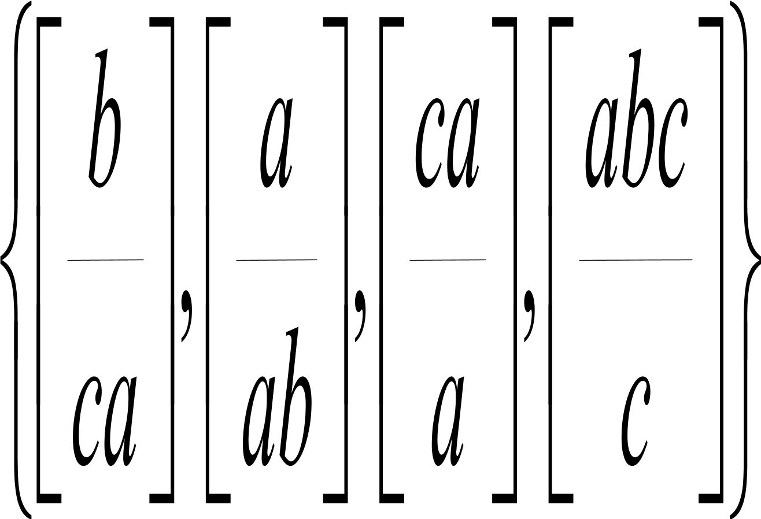
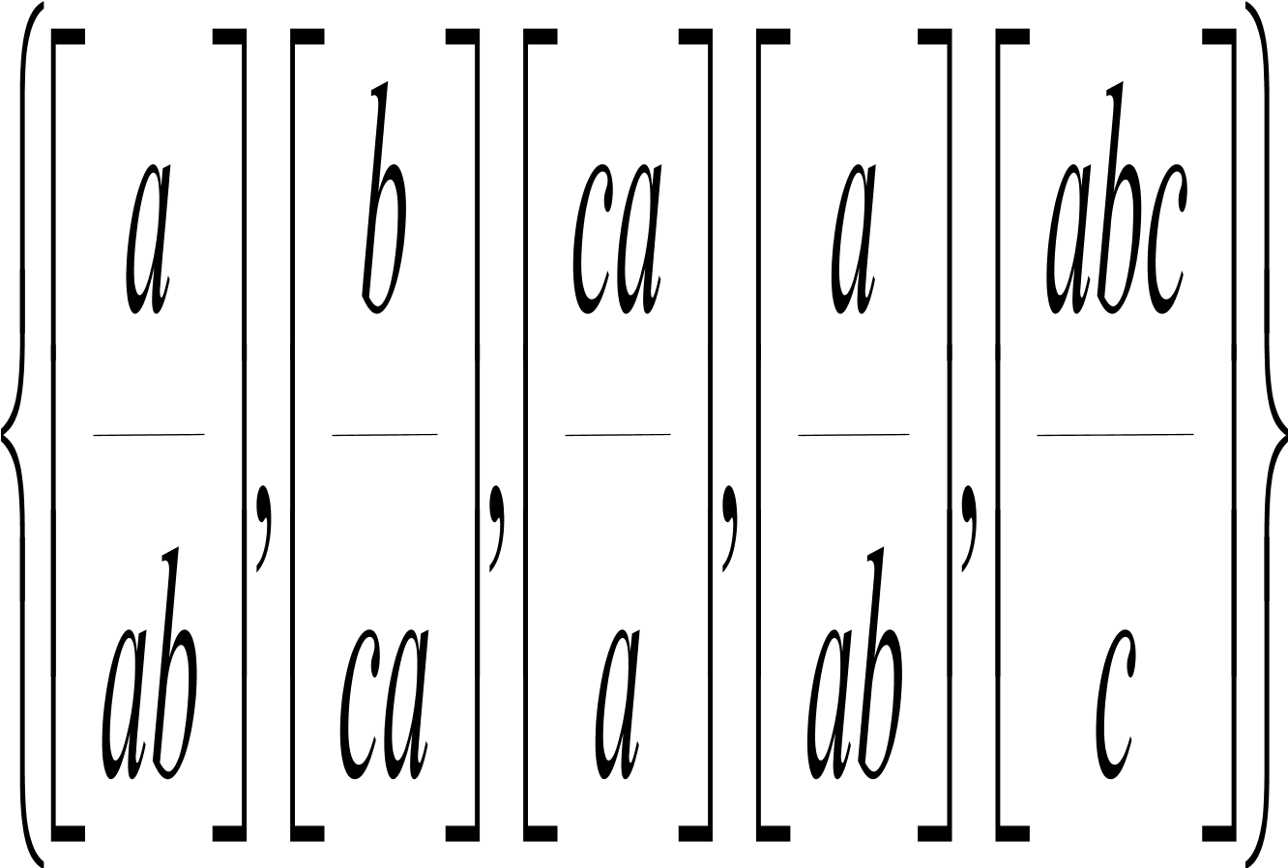
Post correspondence problem(PCP)
Given a collection of dominos
the task is to make a list of these dominos (repetitions permitted) so that the string we get by reading off the symbols on the top is the same as the string of symbols on the bottom. The above problem has a list as a solution, which is called a match.

Slide 22
PCP is undecidable
First we show the following modified PCP is undecidable
MPCP={<P>: P is an instance of the PCP with a match that starts with the first domino}
Proof idea: Given <M,w>, construct a collection P of dominos such that P has a match iff this match is an accepting computation history for M on w.

Slide 23
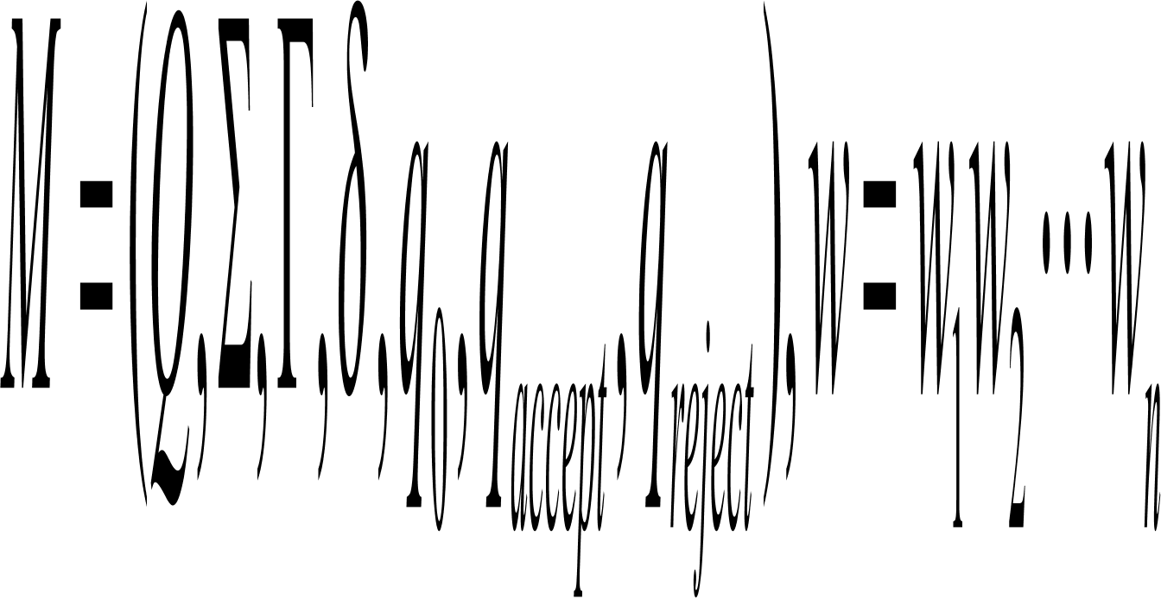
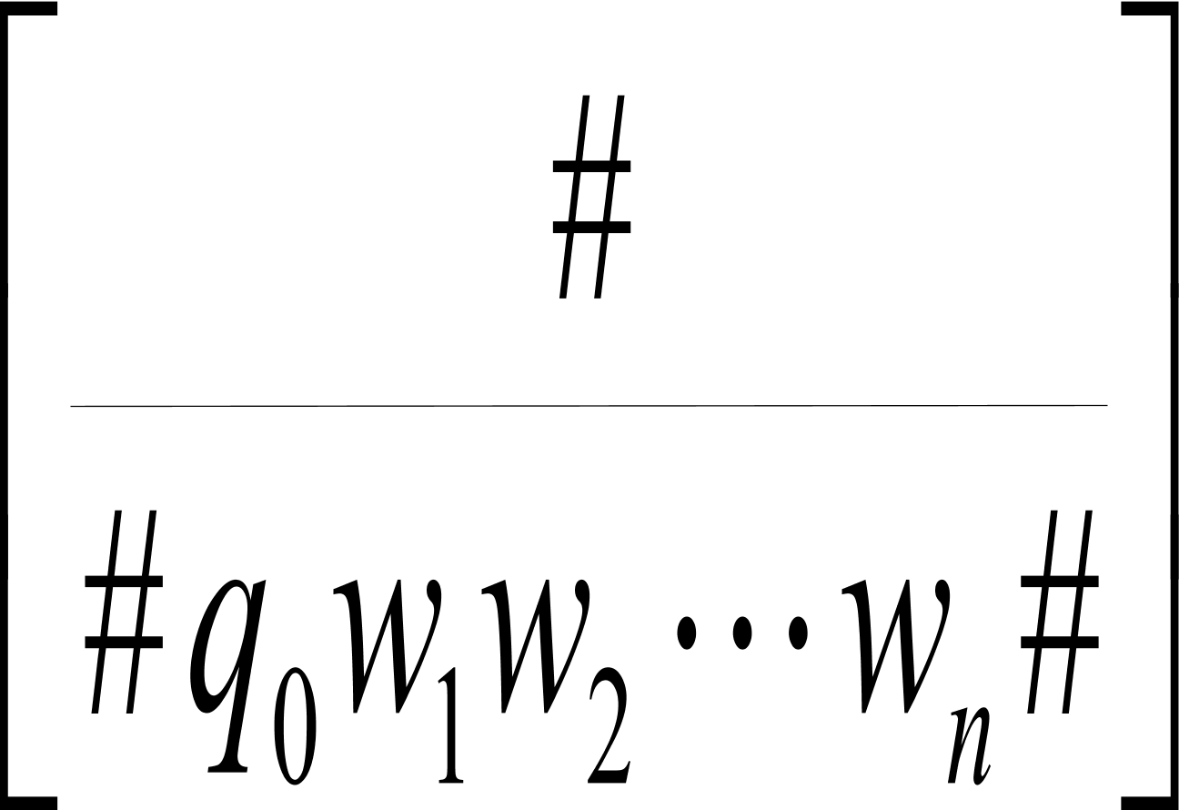
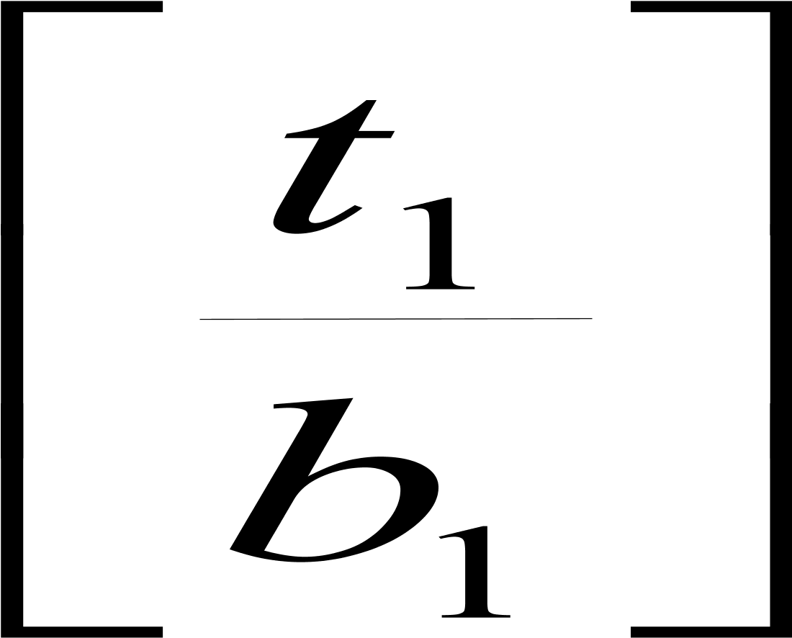
Part 1: Start configuration
Fix M and w as follows:
The construction of P’ begins by
putting into P’ as the first domino

Slide 24
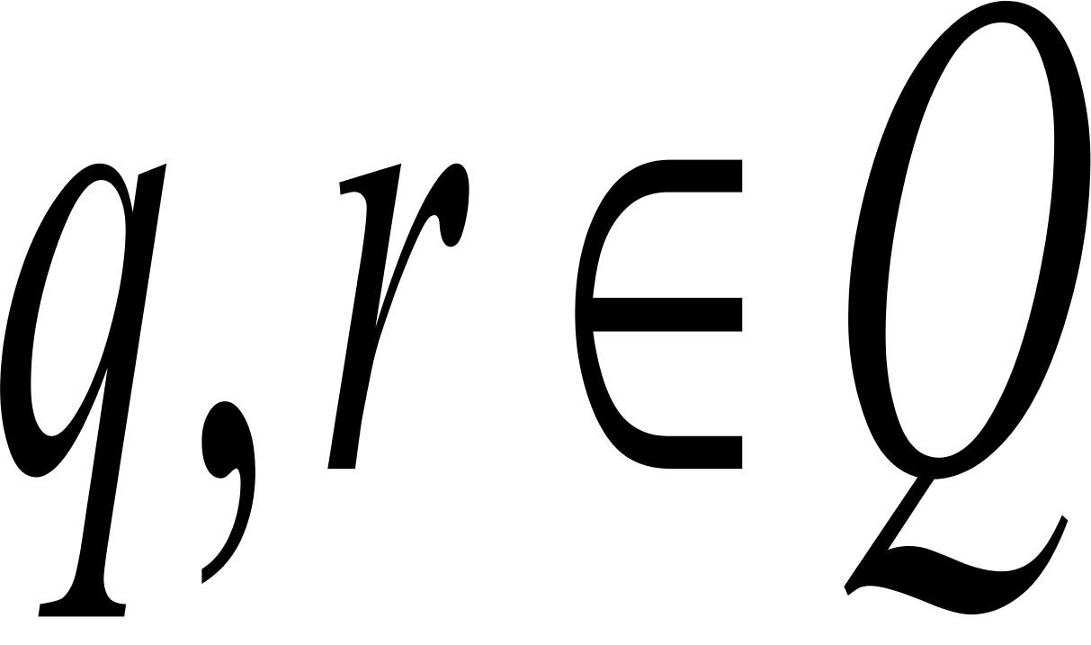

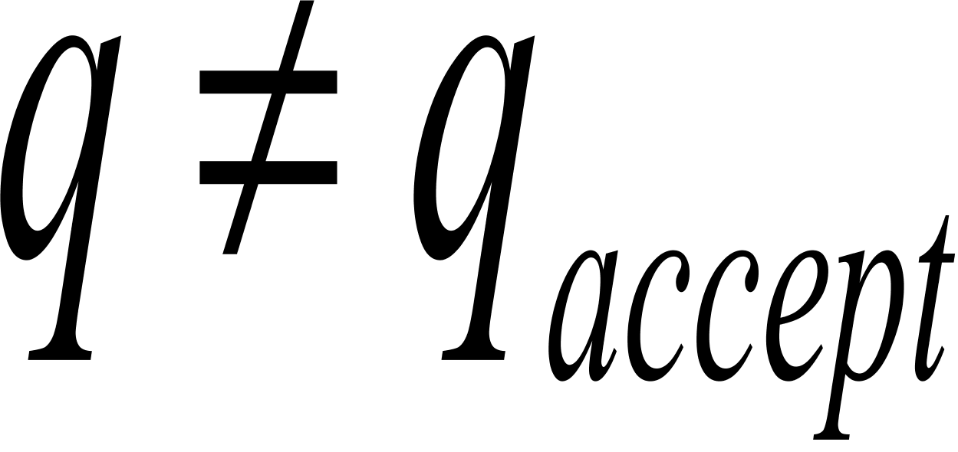
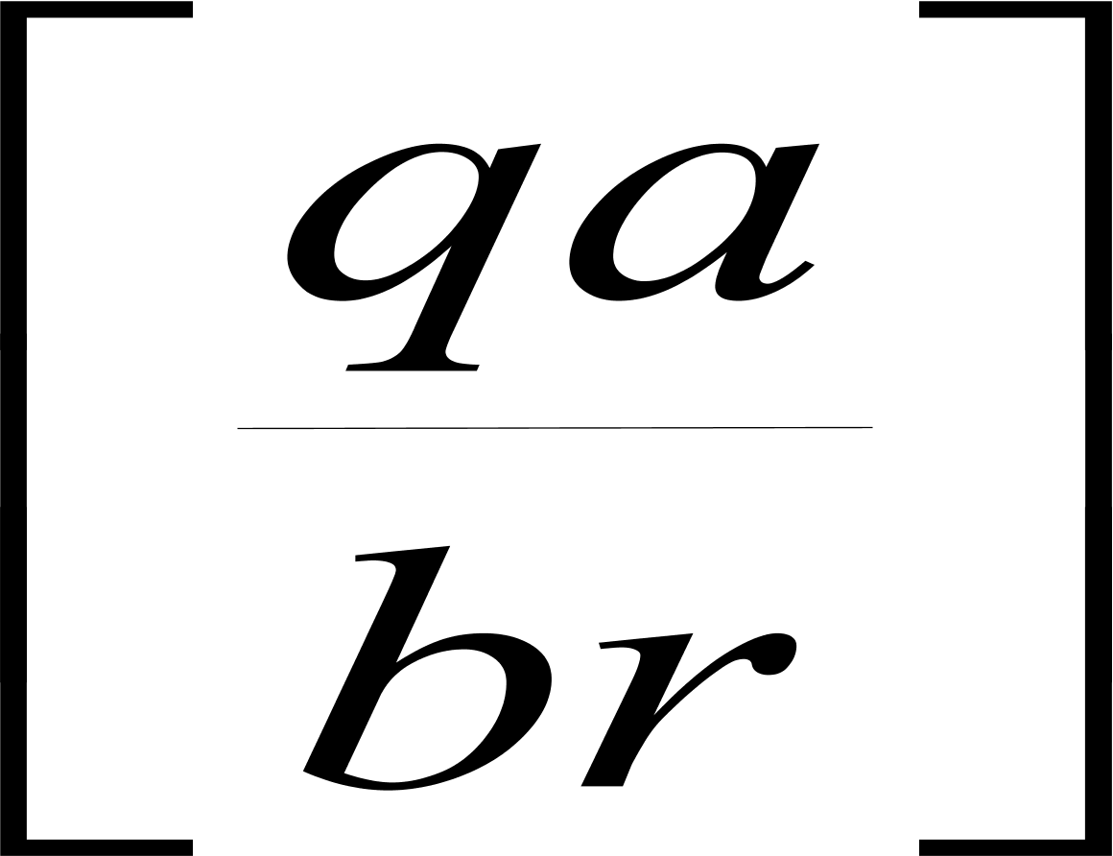
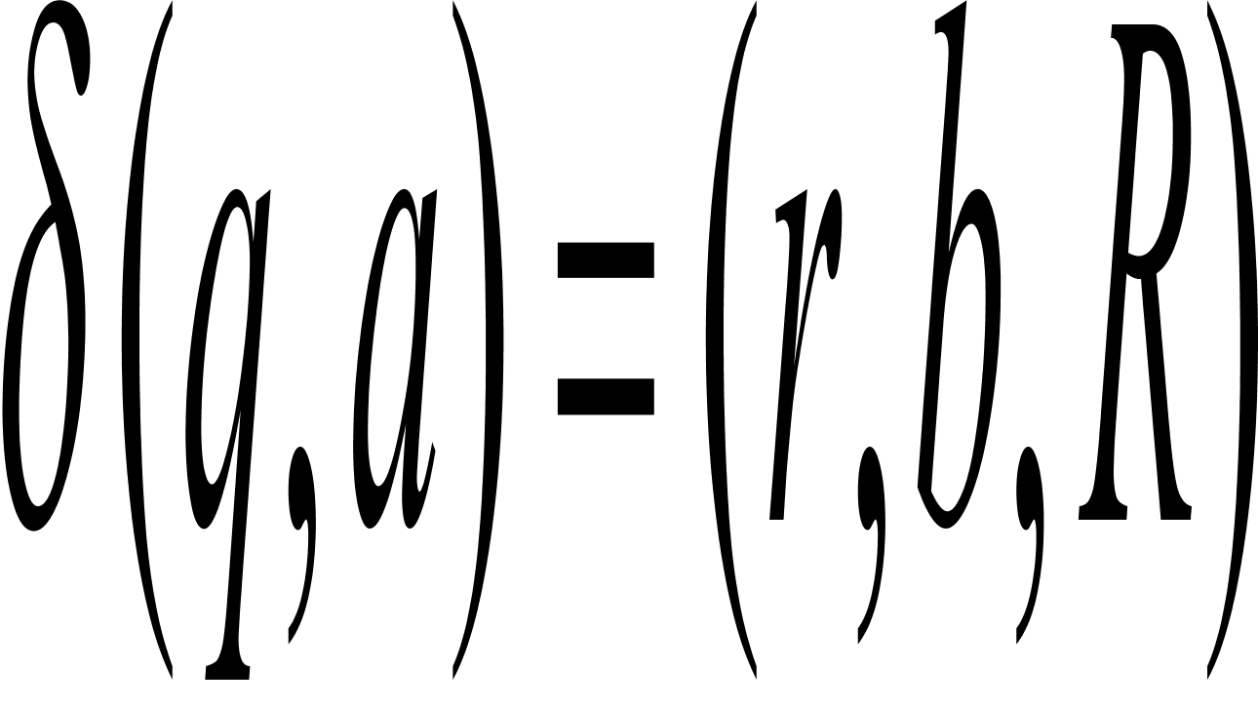

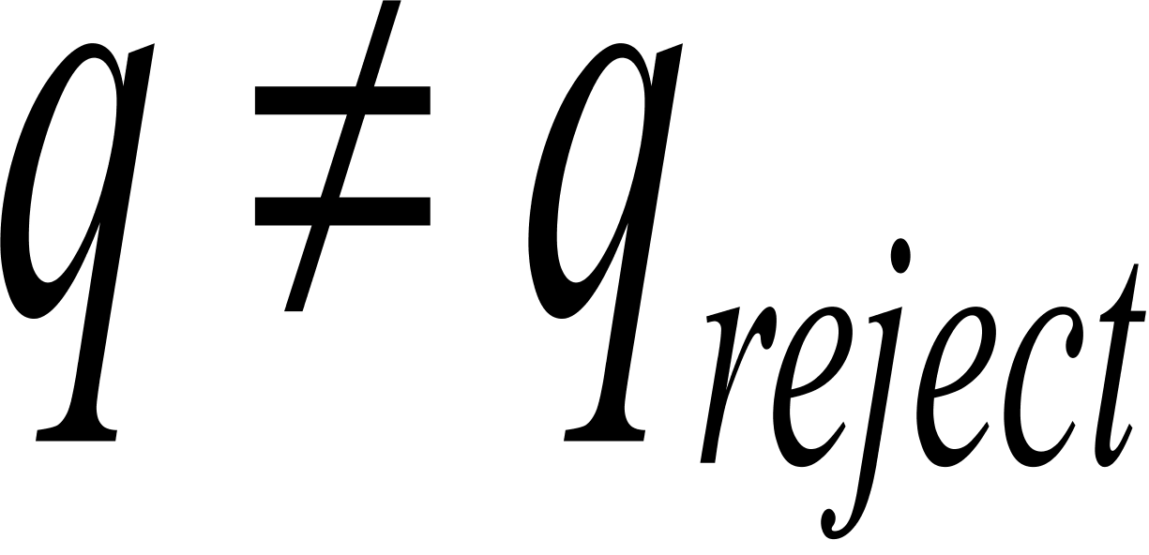
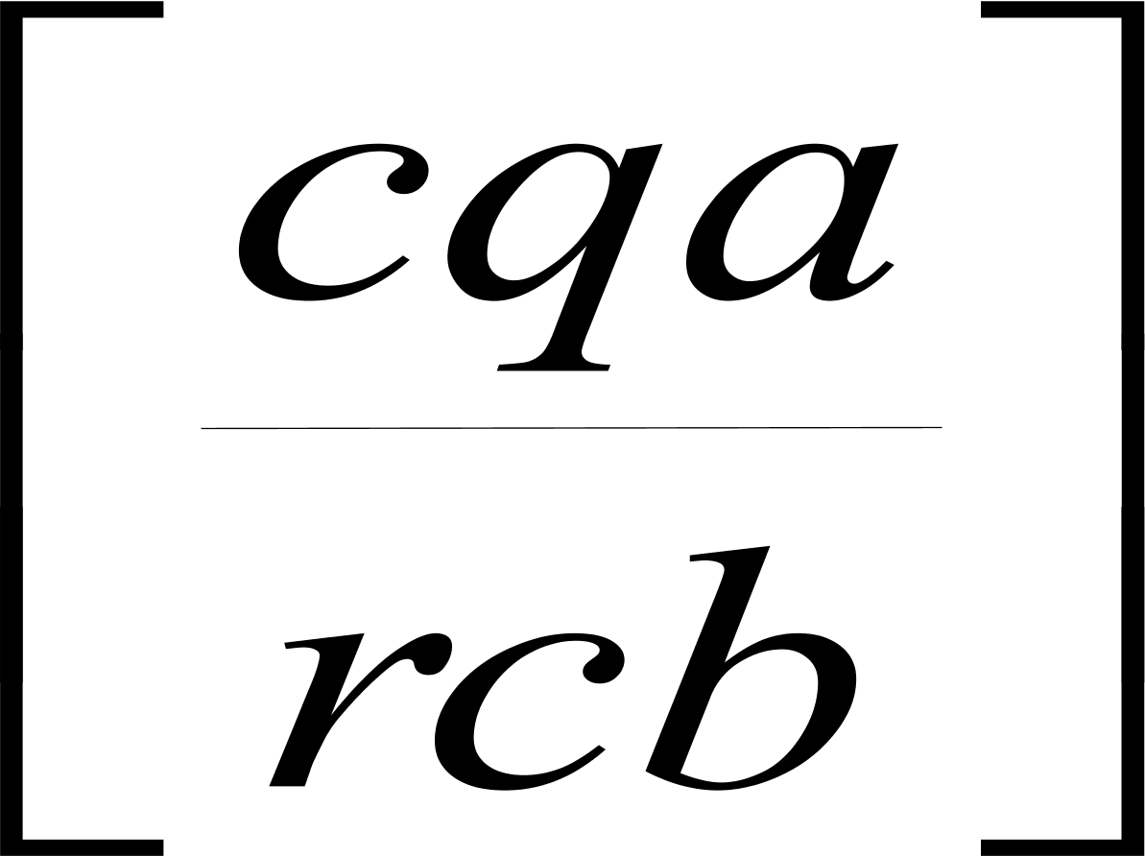
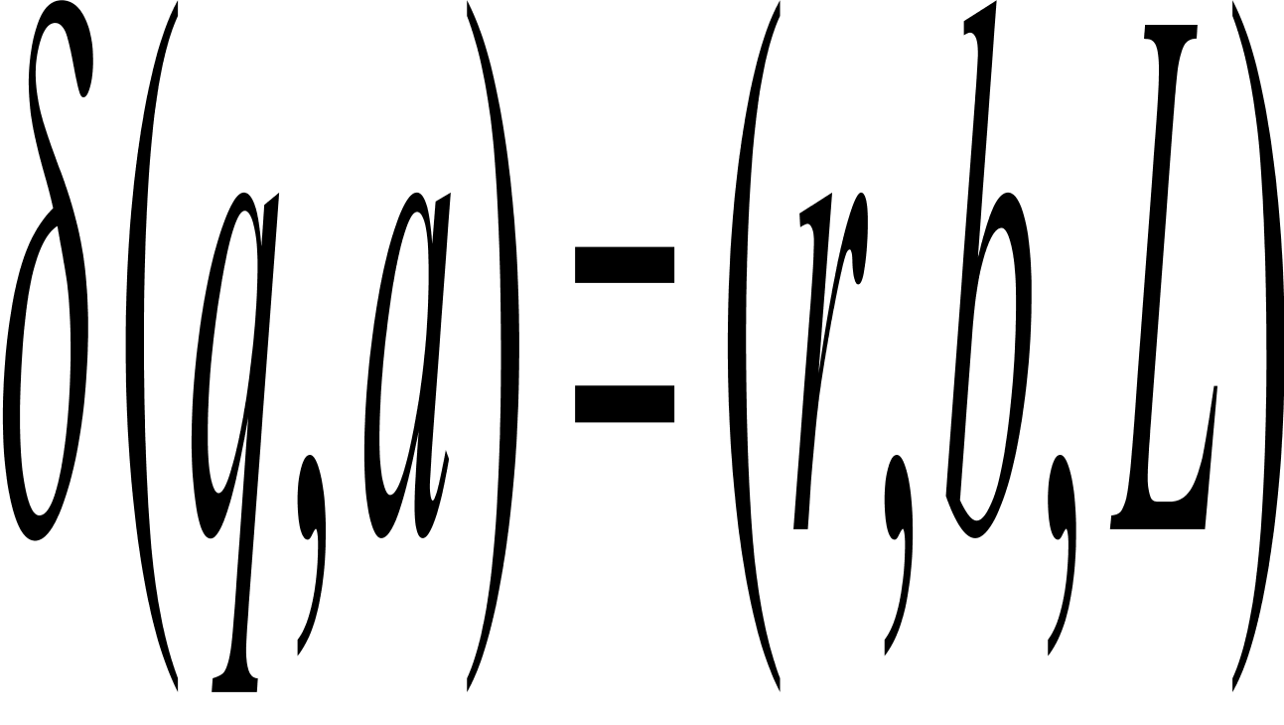
Parts 2 and 3: transition function
Part 2: For every and every where
if put into P’
Part 3: For every and every where
if put into P’

Slide 25
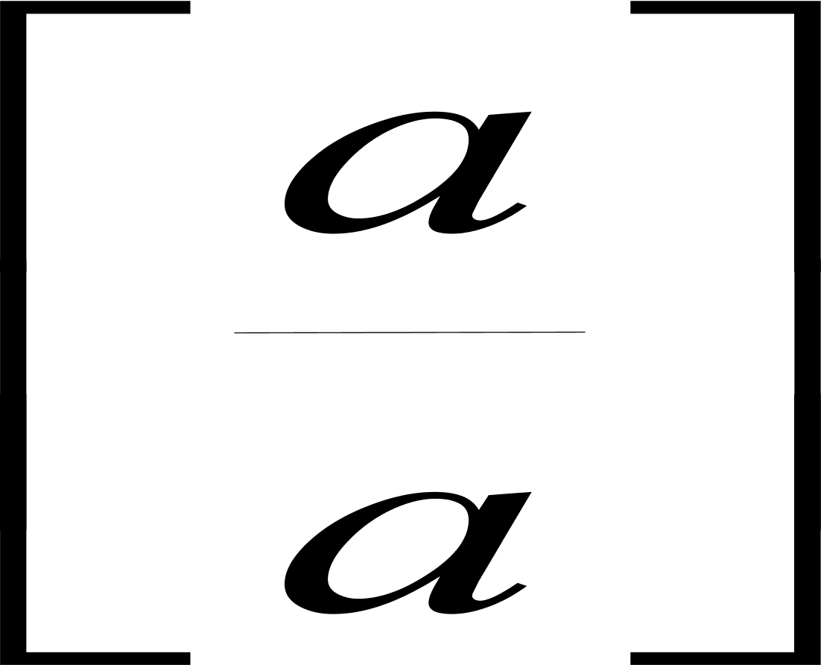


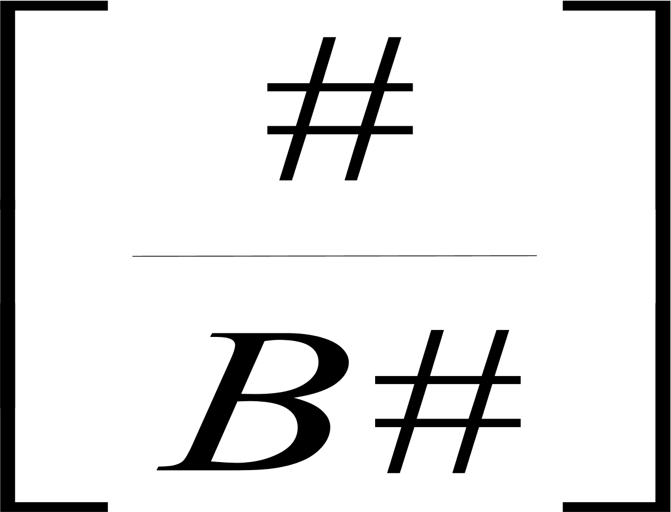
Parts 4 and 5: untouched squares
Part 4: For every put into P’
Part 5: For delimiter #,
put and into P’

Slide 26
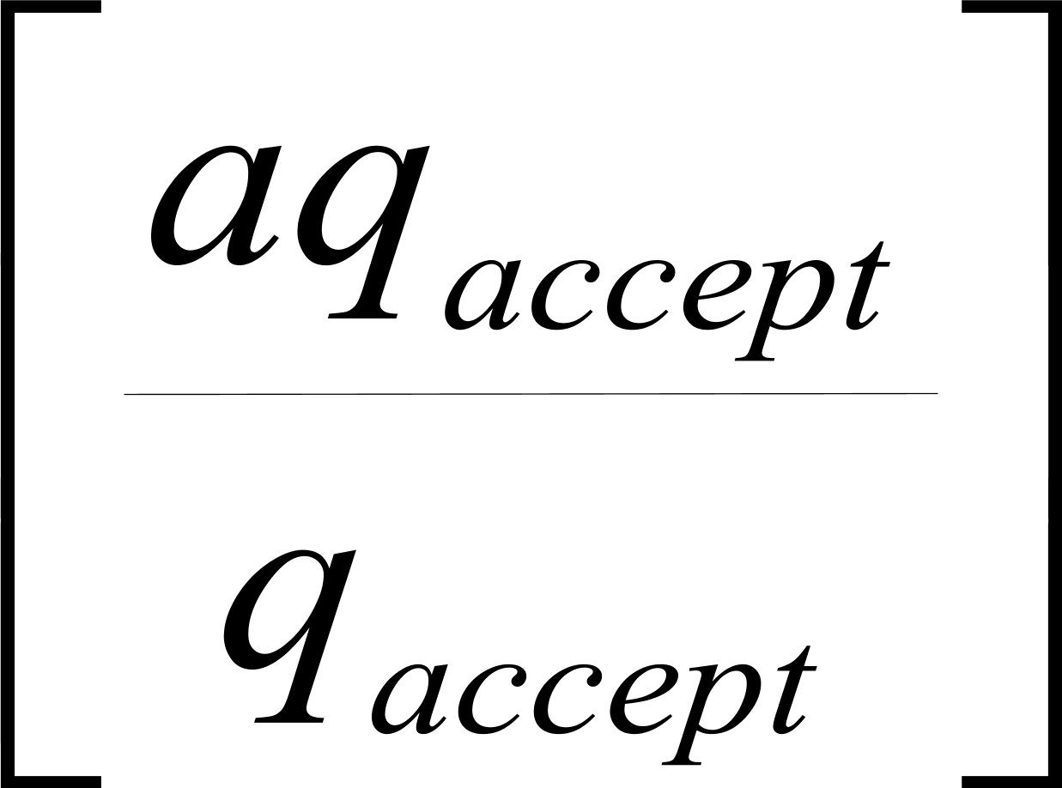
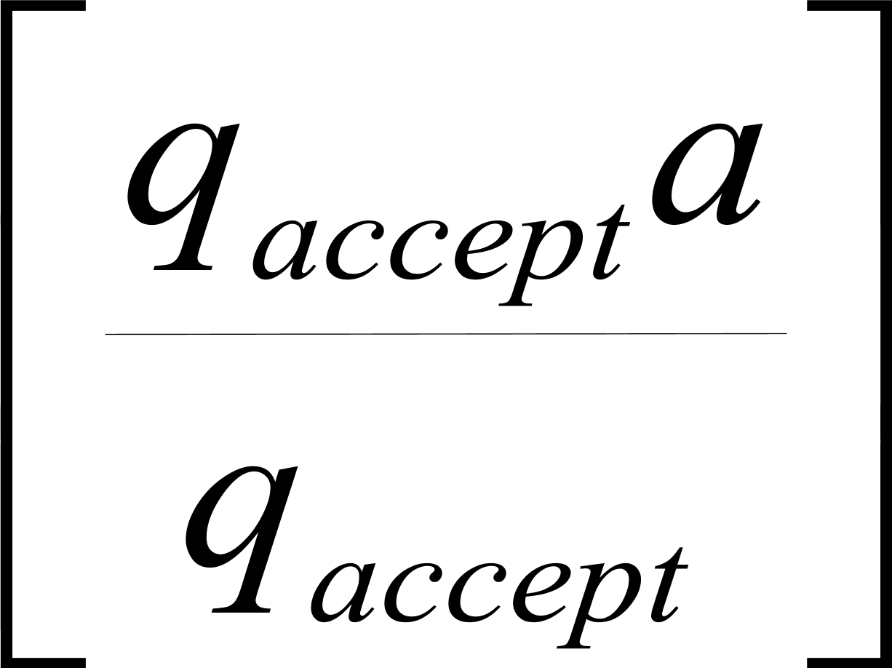
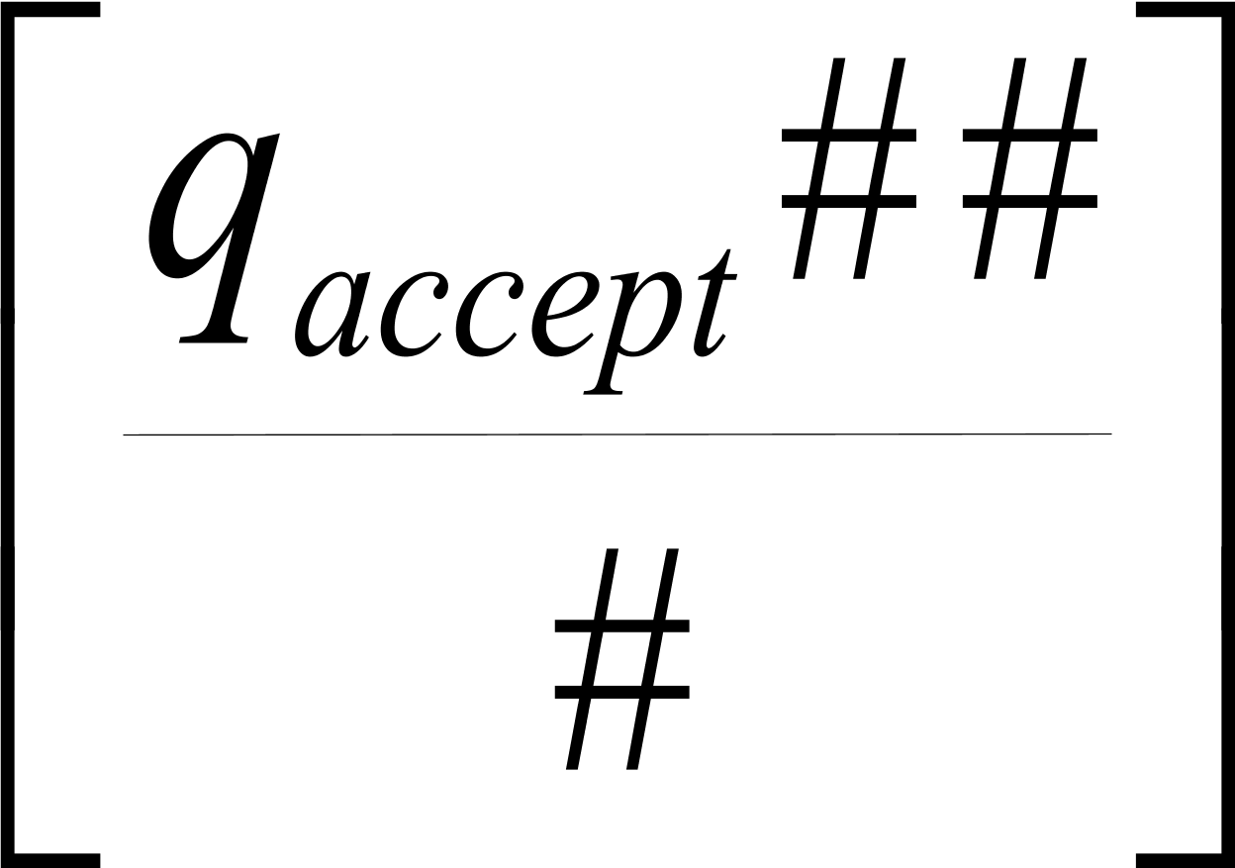
Part 6: Accepting configuration
Part 6: For every
put and into P’
Part 7: Finally we add the domino

Slide 27
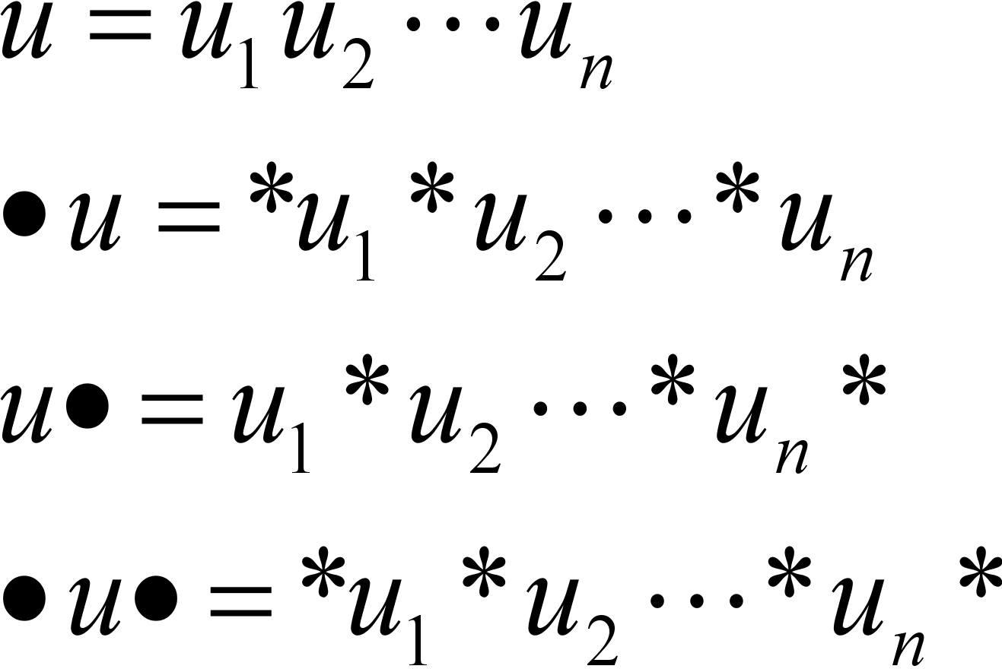
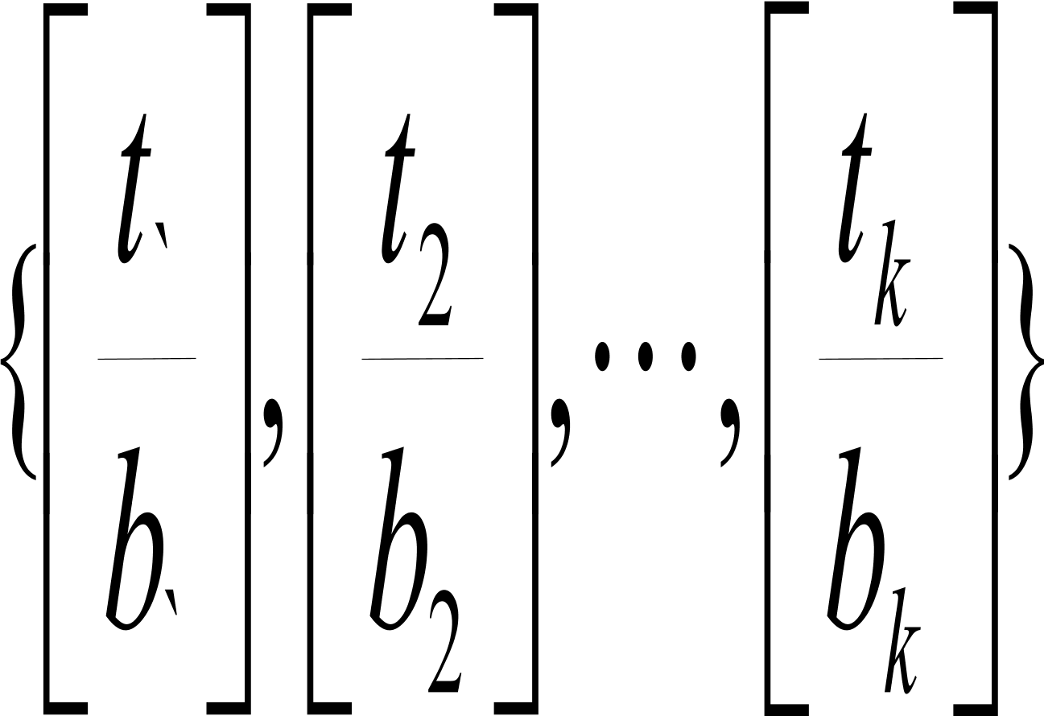
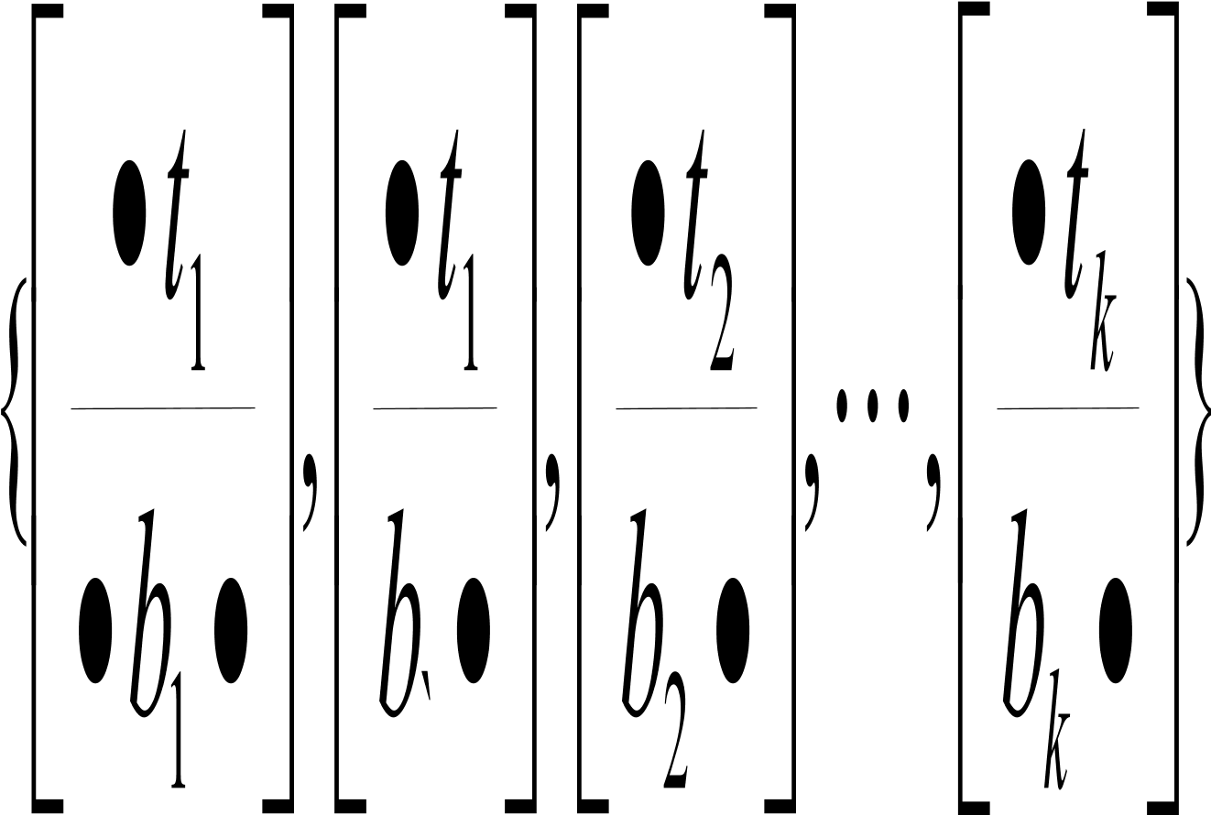
Converting MPCP to PCP
Let
Convert
into

Slide 28
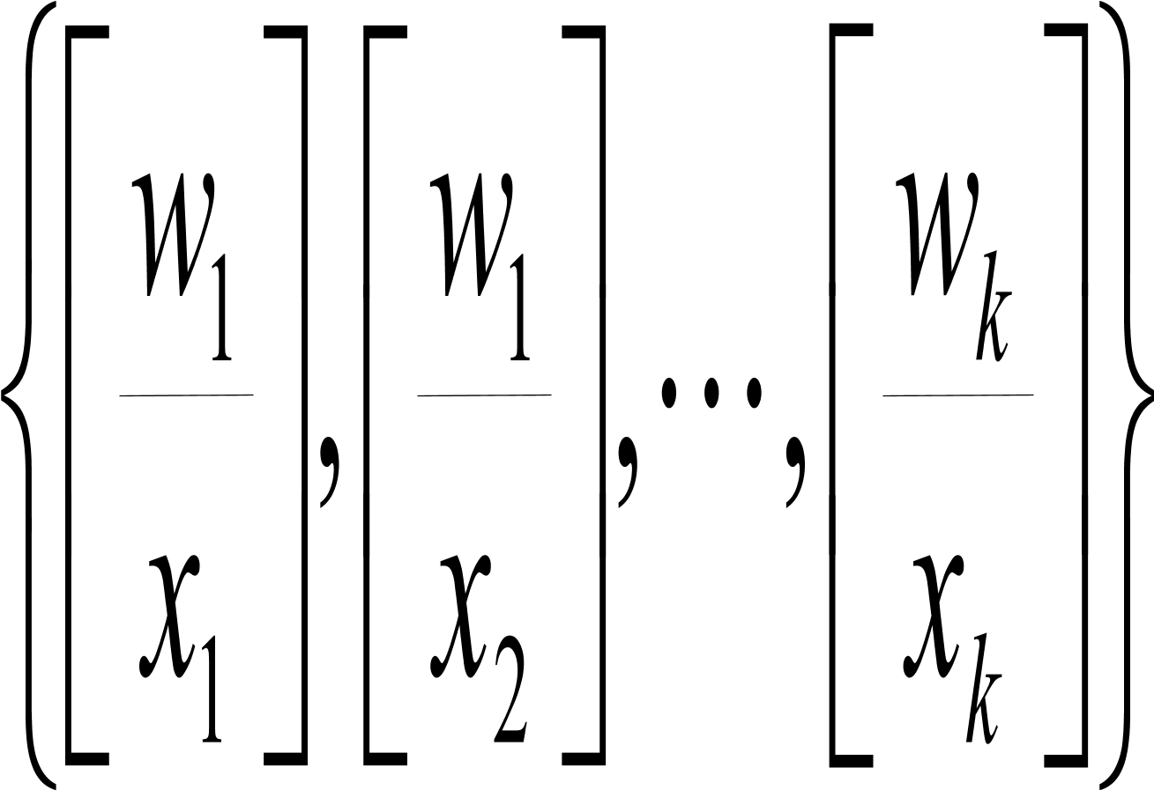
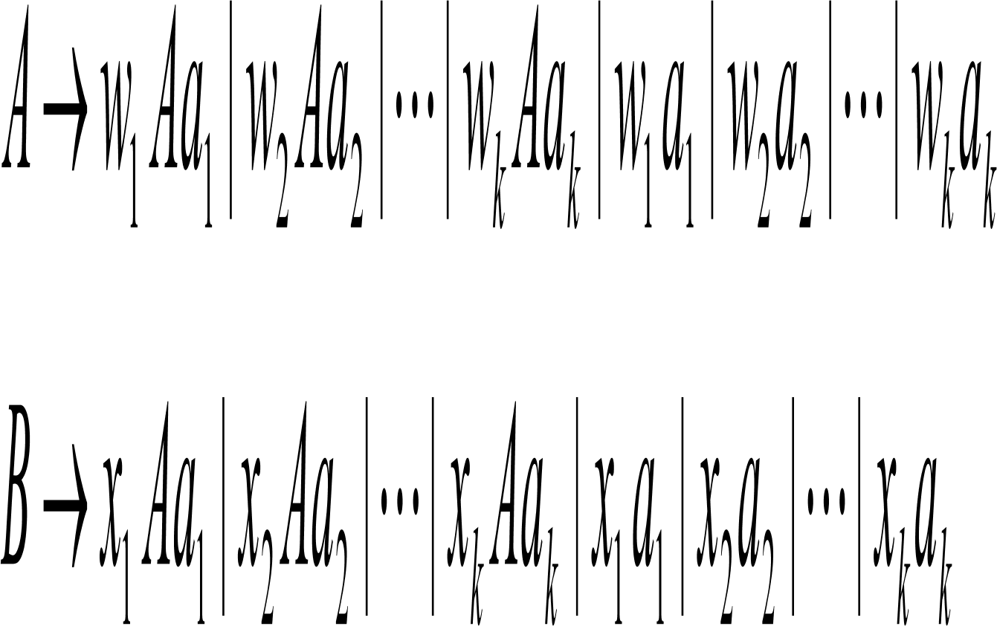
Undecidability of ambiguity for CFGs
Fix a collection of dominos:
Construct two CFGs as follows
Each of them is unambiguous.

Slide 29
Reduce PCP to Ambiguity Problem
For this collection P of dominos, combine the above two CFGs by adding the new start symbol S and a new rule S -> A|B. Call this CFG GP.
Reduction step: If P has a match, then GP is ambiguous; if P does not have a match, then GP is unambiguous.
So it is undecidable whether a CFG is ambiguous or not.

Slide 30
Decision Problems for automata and TMs
Here we take PDA as an example.
The following problems are decidable
APDA
EPDA
Every CFL is a decidable language.
There are no algorithms to decide the following problems
EQPDA
Ambiguity problem for CFGs
NO!!
Compare this list for PDA with those for NFA and for TM

